Slide 1
Agents Lab 1

Slide 2
Agenda
Table-driven agent
Simple reflex agent
Reflex agent with state/memory
Homework

Slide 3
Table-driven agent

Slide 4
Table-driven agent
Refer to table_driven_agent.py
table_definition contains all possible percepts that can occur
Each step appends current percept to list of percepts
LOOKUP current percepts in table

Slide 5

Table-driven agent
function TABLE_DRIVEN_AGENT(percept) returns an action
static: percepts, a sequence, initially empty
table, a table of actions, indexed by percept sequences, initially fully specified
append percept to the end of percepts
action = LOOKUP(percepts, table)
return action

Slide 6
Exercise 1 – A complicated history
Run the module (using run())
The percepts should now be: [(‘A’, ’Clean’), (‘A’, ’Dirty’), (‘´B’, ’Clean’)]
The table contains all possible percept sequences to match with the percept history
Enter: print(TABLE_DRIVEN_AGENT((B, 'Clean')), '\t', percepts)
Explain the results
How many table entries would be required if only the current percept was used to select and action rather than the percept history?
How many table entries are required for an agent lifetime of T steps?
Notes:
2.: no entry in percept history → return None as action
3.: 4 → [A,Clean],[A,Dirty],[B,Clean],[B,Dirty]
4.: 4^T

Slide 7
Reflex vacuum agent using condition-action rules and if statements

Slide 8
Reflex vacuum agent
Refer to reflex_vacuum_agent.py
Only responds to current percept (location and status) ignoring percept history
Uses condition-action rules rather than a table
if condition then return action
e.g. if status = Dirty then return Suck
Sensors() – Function to sense current location and status of environment (i.e., location of agent and status of square)
Actuators(action) – Function to affect current environment location by some action (i.e., Suck, Left, Right, NoOp)

Slide 9
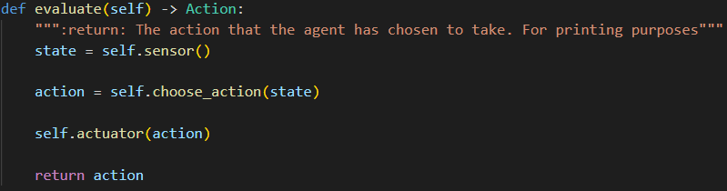
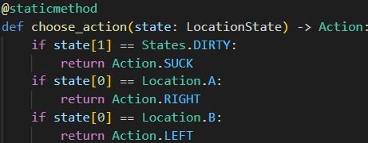
Simple reflex agent
function REFLEX-VACUUM-AGENT( [location, status] )
returns an action
if status = Dirty then return Suck
else if location = A then return Right
else if location = B then return Left

Slide 10
Exercise 2 – Bogus actions
Run the module
Enter run(10)
Should bogus actions be able to corrupt the environment? Change the REFLEX_VACUUM_AGENT to return bogus action, such as Left when it should go Right etc. Run the agent. Do the Actuators allow bogus actions?
Notes:
Environment can be corrupted by bogus actions

Slide 11
Exercise 3 – A whole new world
Extend the REFLEX_VACUUM_AGENT (Exercise 2) program to have 4 locations (4 squares)
The agent should only sense and act on the square where it is located
Allow any starting square
Use run(20) to test and display results
Hint investigate Enums.py

Slide 12
Reflex agent with state/memory

Slide 13
Reflex agent with state
A reflex agent only responded to current percepts; no history or knowledge
Model-based reflex agents:
Maintain internal state that depends upon percept history
Agent has a model of how the world works
The model requires two types of information to update:
How environment evolves independent of the agent (e.g., Clean square stays clean)
How agent’s action affect the environment (e.g., Suck cleans square)

Slide 14
Reflex agent with state
Refer to reflex_agent_with_state.py
Model – used to update history
History initially empty: model = {A: Unknown, B: Unknown}
Model only used to change action when A == B == ‘Clean’ if model[A] == model[B] == ‘Clean’: action= NO_OP

Slide 15
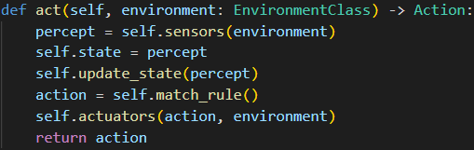
Reflex agent with state
function REFLEX-AGENT-WITH-STATE( percept ) returns an action
static: state, a description of the current world state
rules, a sequence, a set of condition-action rules
action, the most recent action, initially none
state = UPDATE-STATE( state, action, percept )
rule = RULE-MATCH( state, rules )
action = RULE-ACTION[ rule ]
return action

Slide 16
Homework

Slide 17
Homework 1 – Remembering the whole world
Extend the REFLEX_AGENT_WITH_STATE program to have 4 locations
The agent should only sense and act on the square where it is located
Allow any starting square
Use run(20) to test and display results

